Slide 1
Influenza Antigenic Distances Derived from Cartography and Amino Acid Sequences
Amanda Lee Skarlupka
11/19/2021
Infectious Diseases Ph.D. Candidate
Ross Laboratory
Center of Vaccines and Immunology
Department of Infectious Diseases
University of Georgia
Biostatistics and Epidemiology M.S. Student
Handel Group
Department of Biostatistics and Epidemiology
School of Public Health
University of Georgia

Slide 2
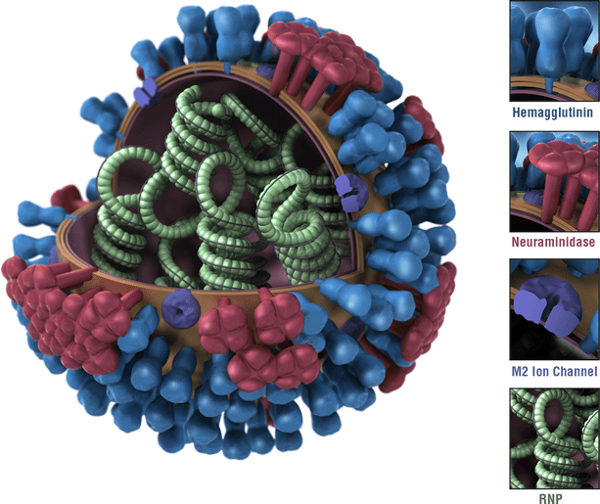
Influenza virus
Influenza A Virus Particle
Respiratory (-) ssRNA virus
Two major surface proteins
Hemagglutinin
Attachment/Fusion
18 subtypes
Neuraminidase
Motility and Budding
11 subtypes
Correlates of protection:
HA inhibiting antibodies – Well accepted
NA inhibiting antibodies – Recently proposed
Image from: https://www.cdc.gov/flu/about/viruses/types.htm

Slide 3
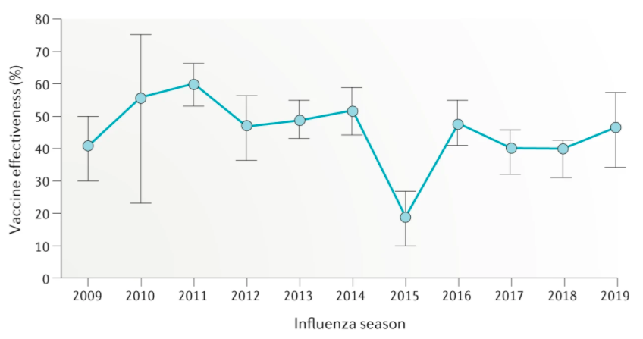
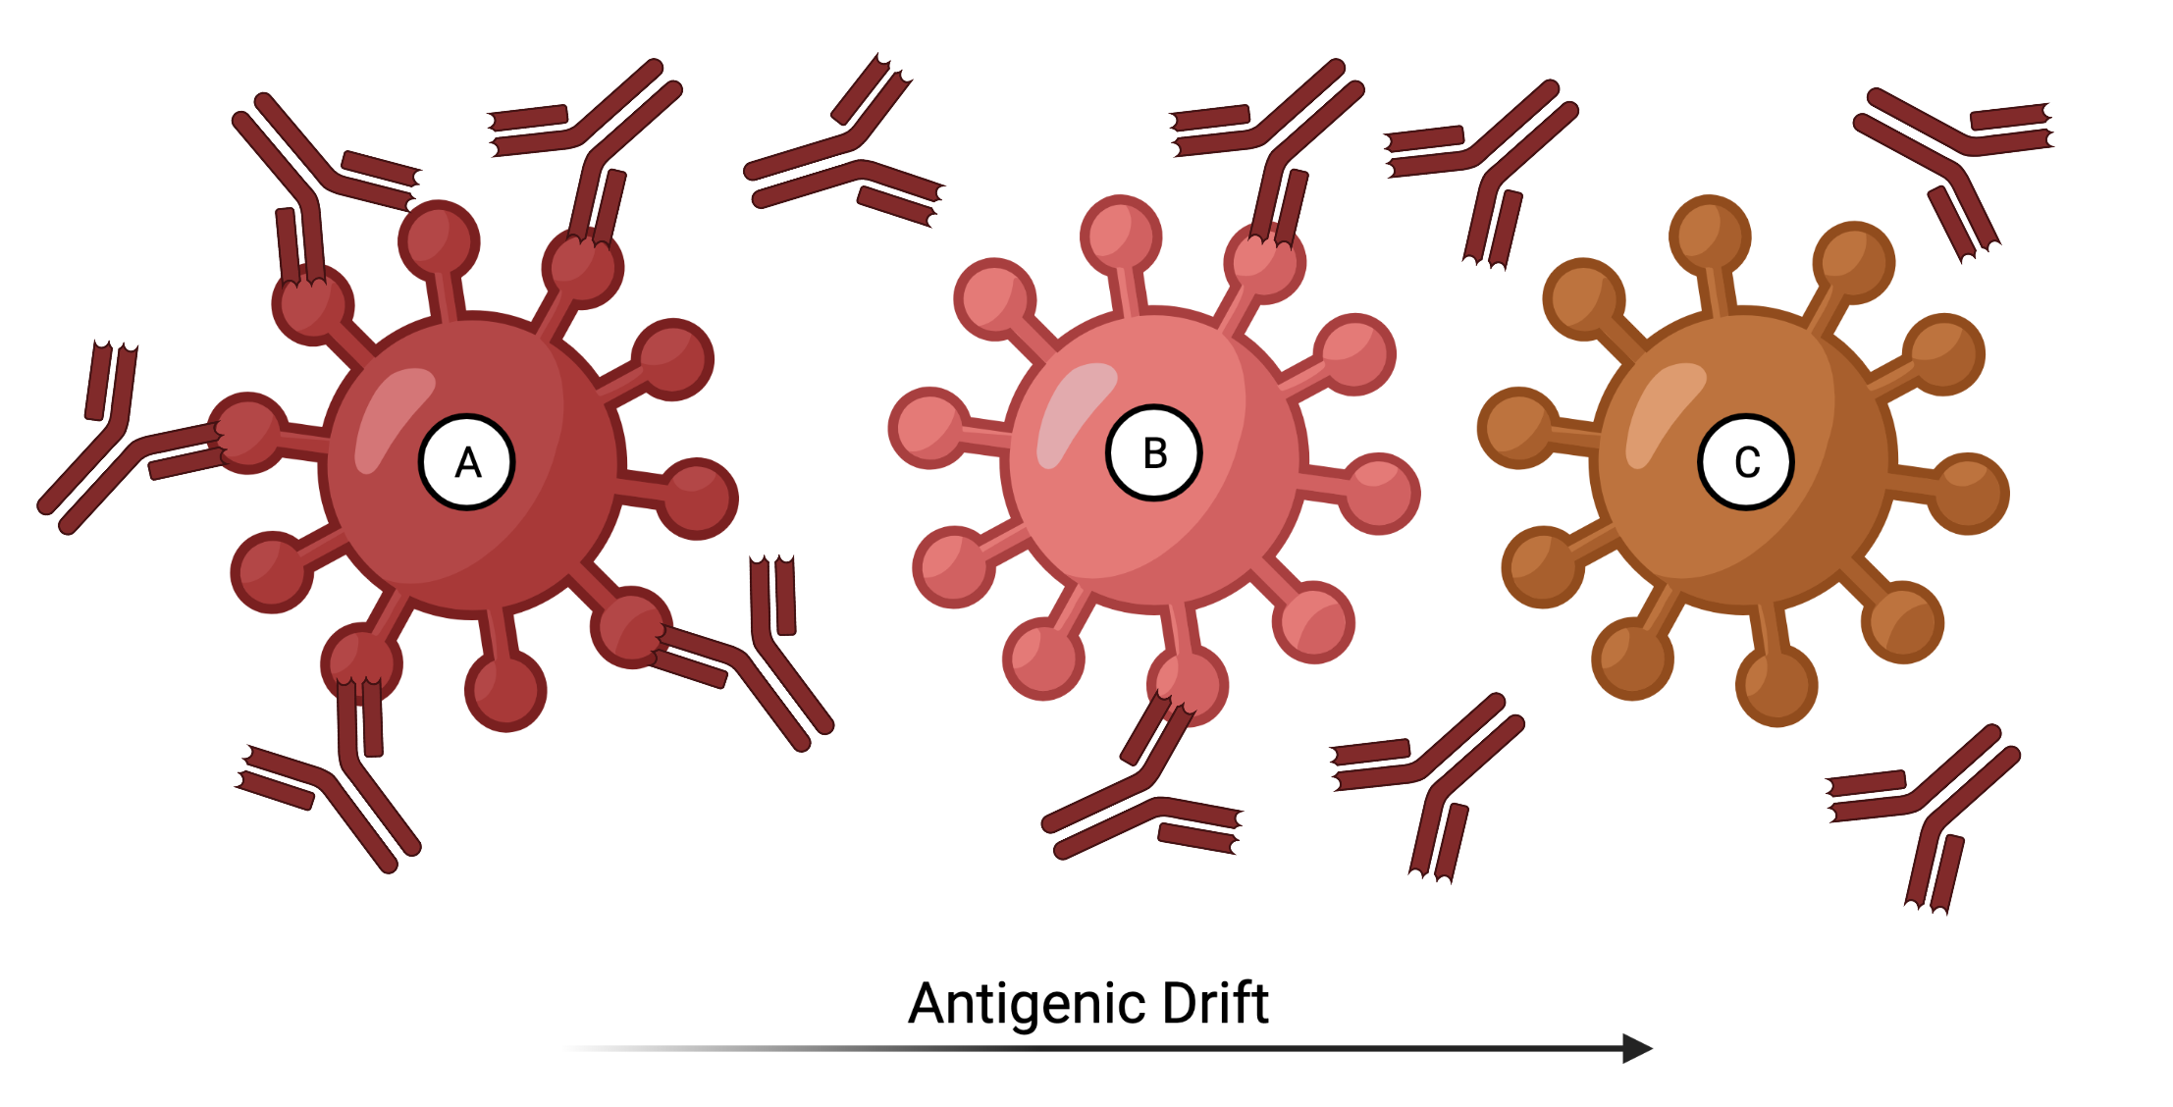
Influenza vaccines
Current influenza vaccine effectiveness maintained between 40-60%
Split-inactivated virus vaccines
H1N1
H3N2
Yamagata Lineage
Victoria Lineage
Standard-of-care
Insufficiently induces protection to genetically/antigenically drifted viruses
Wei, CJ., Crank, M.C., Shiver, J. et al. Next-generation influenza vaccines: opportunities and challenges. Nat Rev Drug Discov 19, 239–252 (2020). https://doi.org/10.1038/s41573-019-0056-x
Created with BioRender.com
Notes:
CDC’s adjusted overall VE estimate against influenza A and B viruses for all ages was 23%. The adjusted VE estimate against influenza A (H3N2) viruses for all ages was 13%.
Reduced protection against influenza A (H3N2) viruses for the 2014-2015 season was attributed to the fact that more than 80% of circulating influenza A (H3N2) viruses analyzed at CDC were different or “drifted” from the recommended influenza A (H3N2) vaccine virus.

Slide 4
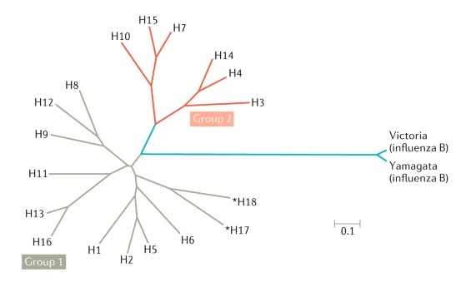
Next Generation of Influenza Vaccines
Vaccine | Breadth
Strain-specific | Current Circulating Strain
Subtype-specific | Multiple strains within a subtype (H1 or H3)
Group-specific | Multiple subtypes within a group
Pan-group | Entire Group
Universal Flu A | All Influenza A
Universal Flu | All influenza A and B
How is the magnitude and breadth of a vaccine response measured?
Wei, CJ., Crank, M.C., Shiver, J. et al. Next-generation influenza vaccines: opportunities and challenges. Nat Rev Drug Discov 19, 239–252 (2020). https://doi.org/10.1038/s41573-019-0056-x

Slide 5
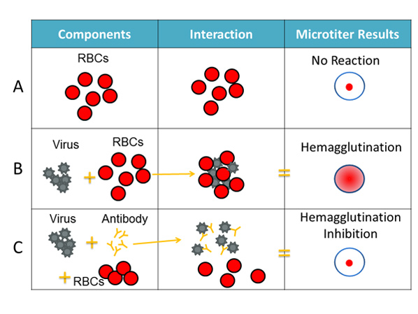
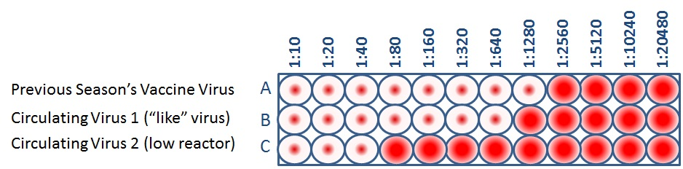
Correlate of Protection assay (HAI)
Hemagglutination Inhibition Assay (HAI)
Indirectly measures antibodies that block receptor binding
Correlate of protection for influenza vaccines
Sera dilution of 1:40 was originally believed to have 50% chance of protection from influenza infection
HAI assay lacks reproducibility and consistency as shown by several inter-laboratory studies
Different variables affect the readout
Red blood cell species, virus passaging, sera handling
Sera → liquid fraction of blood that contains circulating antibodies
Image from: https://www.cdc.gov/flu/about/viruses/types.htm

Slide 6
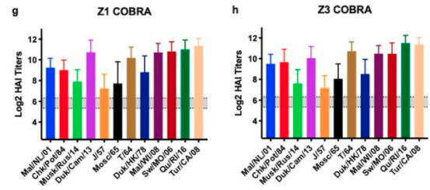
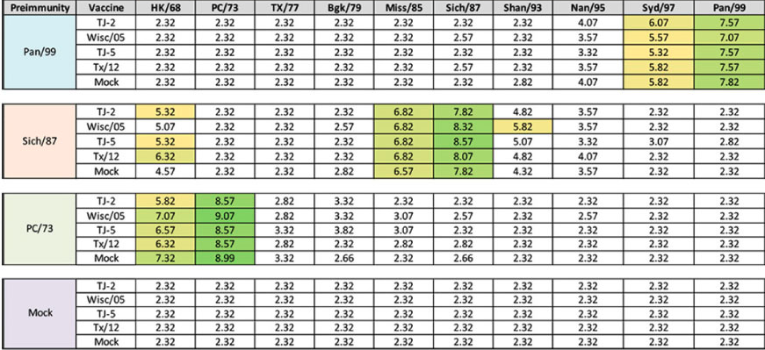
HAI Data Analysis – Counting breadth
Bar charts
Tables
Vaccine-specific antibodies tested against a panel of viruses (x-axis)
HAI titer (y-axis)
Vaccine-specific antibodies (rows) tested against a panel of viruses (columns)
HAI titer (cell values)

Slide 7
How to quantify the differences between strains?
Year of isolation
Not representative of antigenic relatedness
Glycosylation/mutations and Antigenic shifts
Genetic differences
Genetic cluster do not always match antigenic clusters
Methods are becoming more refined
Antigenic cartography
Multiscale dimensional scaling analysis of antibody responses to a distance value

Slide 8
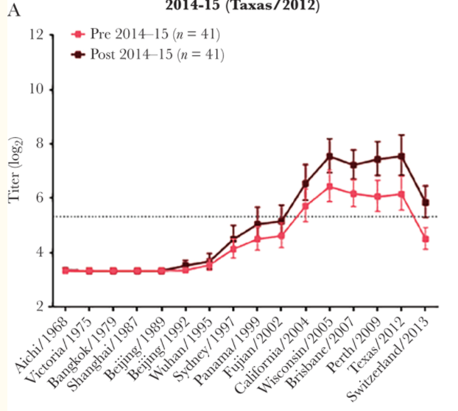
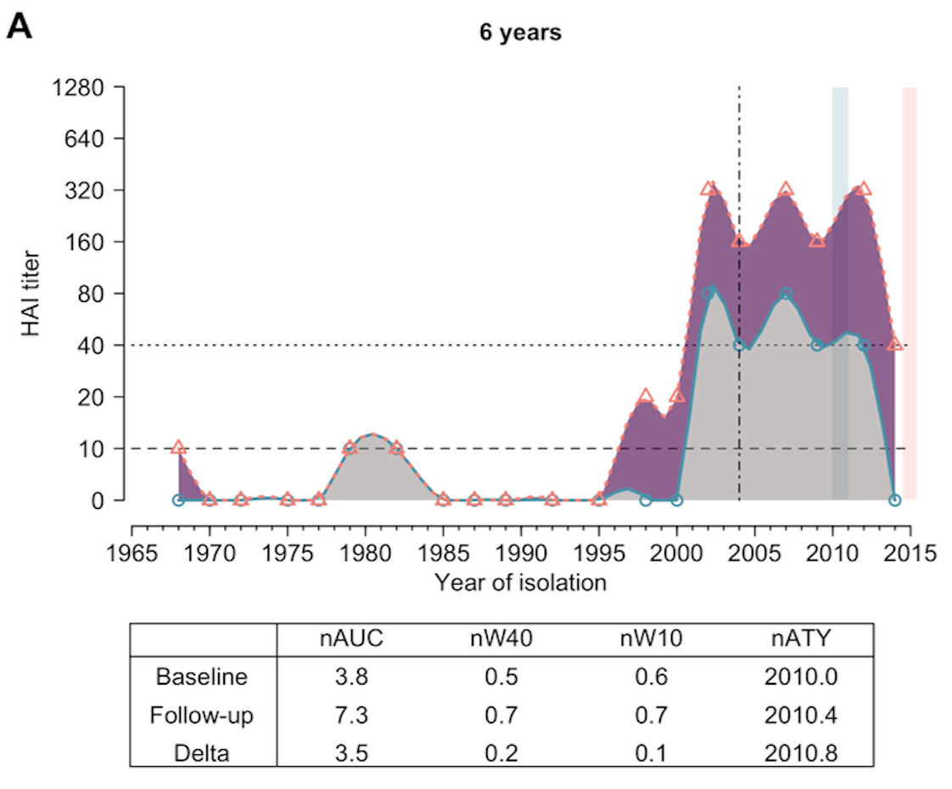
Year of Isolation
X-axis
Representative viruses are chosen again (chronological)
Virus year of isolation
Y-axis
assay result
Does not account for changes in the rate of antigenic drift
Hinojosa M, Shepard SS, Chung JR, et al. Impact of Immune Priming, Vaccination, and Infection on Influenza A(H3N2) Antibody Landscapes in Children. J Infect Dis. 2021;224(3):469-480. doi:10.1093/infdis/jiaa665
Yang B, Lessler J, Zhu H, Jiang CQ, Read JM, Hay JA, et al. (2020) Life course exposures continually shape antibody profiles and risk of seroconversion to influenza. PLoS Pathog 16(7): e1008635. https://doi.org/10.1371/journal.ppat.1008635

Slide 9
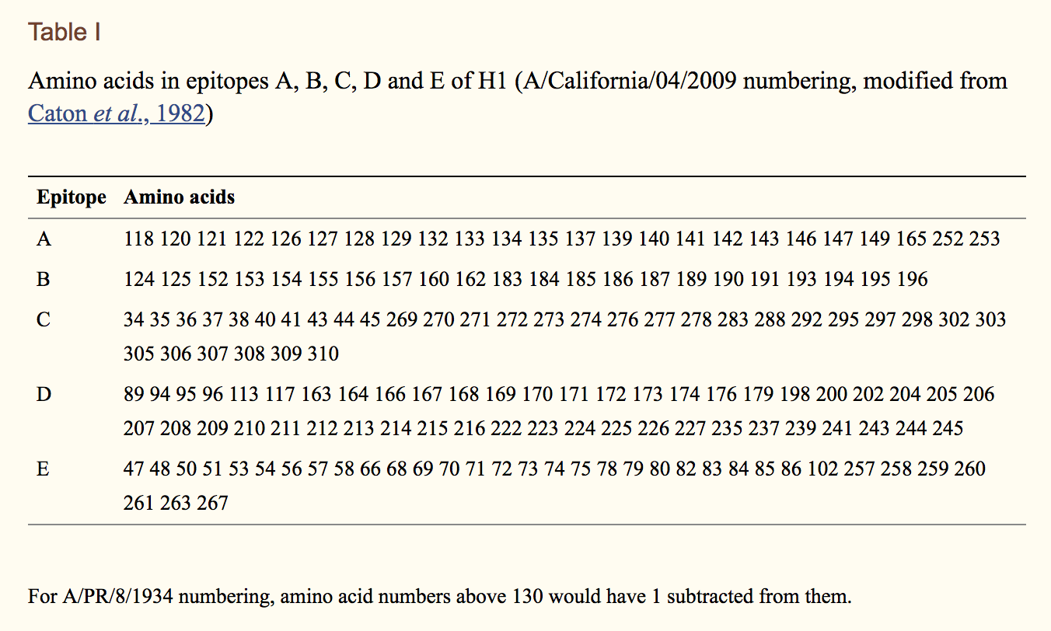
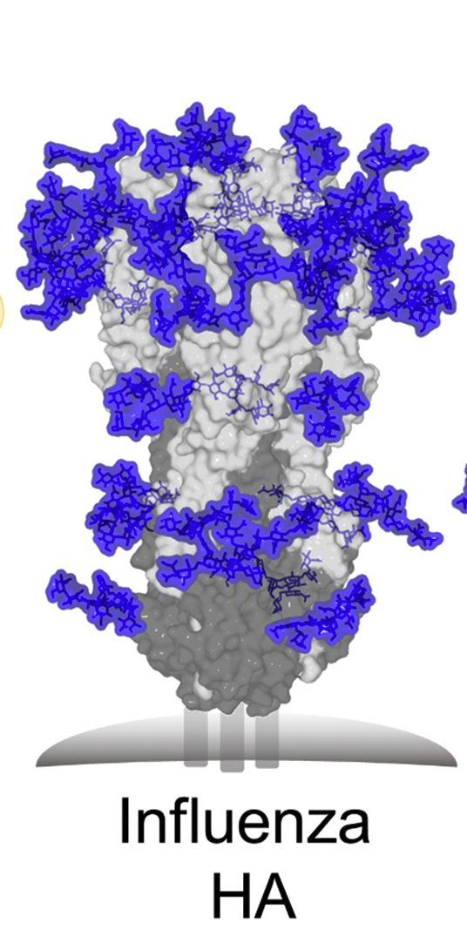
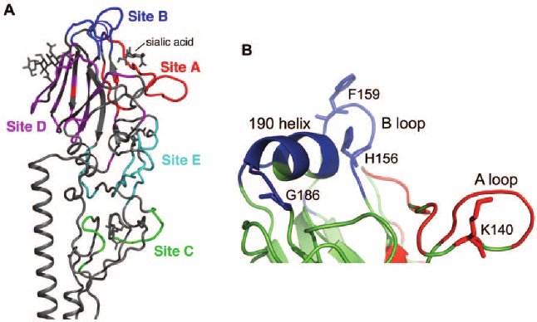
Genetics Methods – Proportion of Differences
Close relationship between genetic and antigenic change
P-all
All of the epitope residues
P-epitope
Proportion for single epitope
P-Dominant epitope
Maximum single epitope proportion
https://www.whocc.infectiousdisease.cam.ac.uk/antigenic-cartography
Notes:
Previous literature
Escape Mutants
Surface Analysis
Site Entropy
Antibody Binding

Slide 10
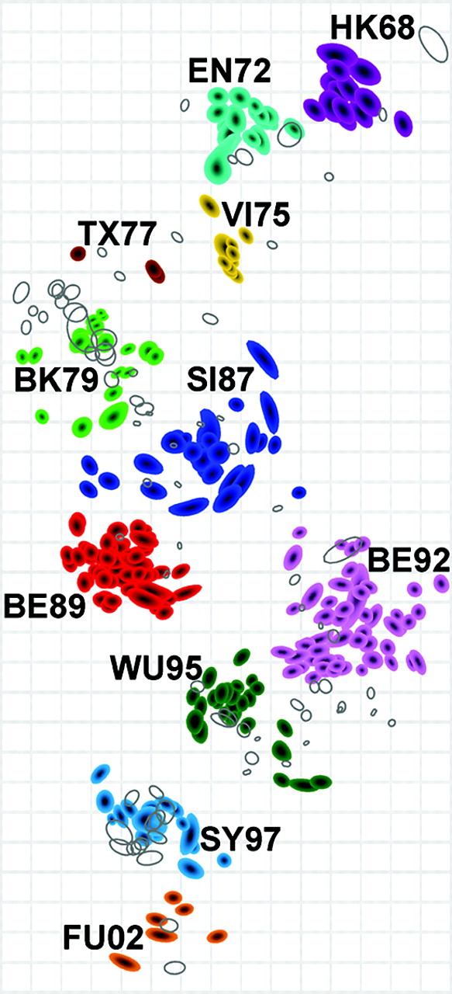
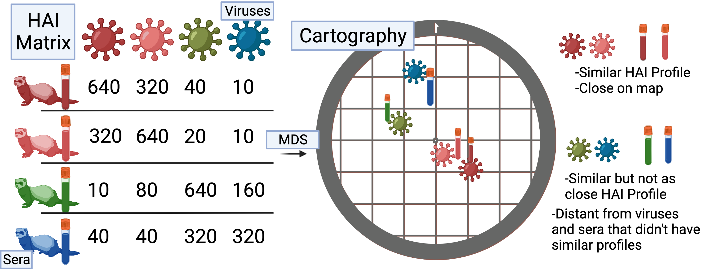
Antigenic Cartography
From the experimental antibody data (HAI titers) create a matrix of [sera x virus]
Grid lines are Antigenic distance units
Distances between viruses can be used as a measurement
Antigenic
Drift
Over
Time
Smith DJ, Lapedes AS, de Jong JC, Bestebroer TM, Rimmelzwaan GF, Osterhaus AD, Fouchier RA. Mapping the antigenic and genetic evolution of influenza virus. Science. 2004 Jul 16;305(5682):371-6. doi: 10.1126/science.1097211. Epub 2004 Jun 24. PMID: 15218094.
Created with BioRender.com
Notes:
Antigenic cartography

Slide 11
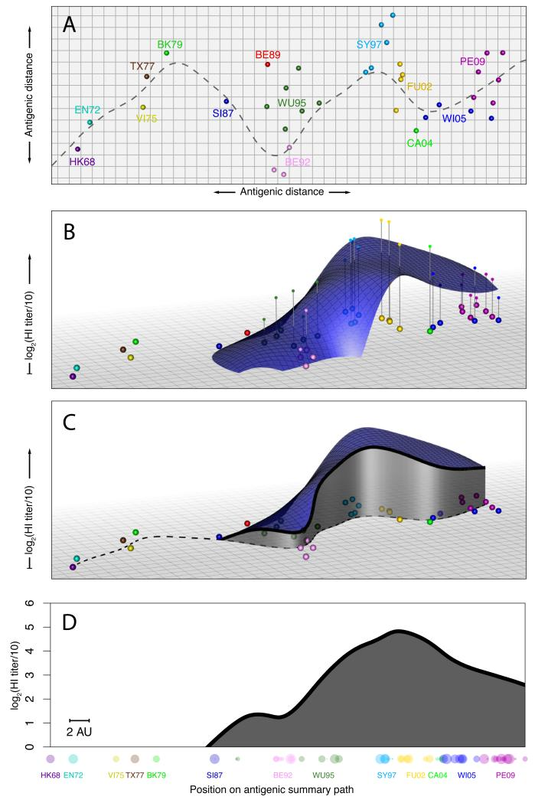
Landscapes include antigenic distance information
Goal: Visualize individual’s breadth to antigenic history
Antigenic cartography
Summary path using time of isolation
Use the individual’s serum titers to the viruses in the Z-axis. Fit locally-weighted multiple linear regression surface
Follow the summary path
Reduce to 2 dimensions
Fonville JM, Wilks SH, James SL, et al. Antibody landscapes after influenza virus infection or vaccination. Science. 2014;346(6212):996-1000. doi:10.1126/science.1256427

Slide 12
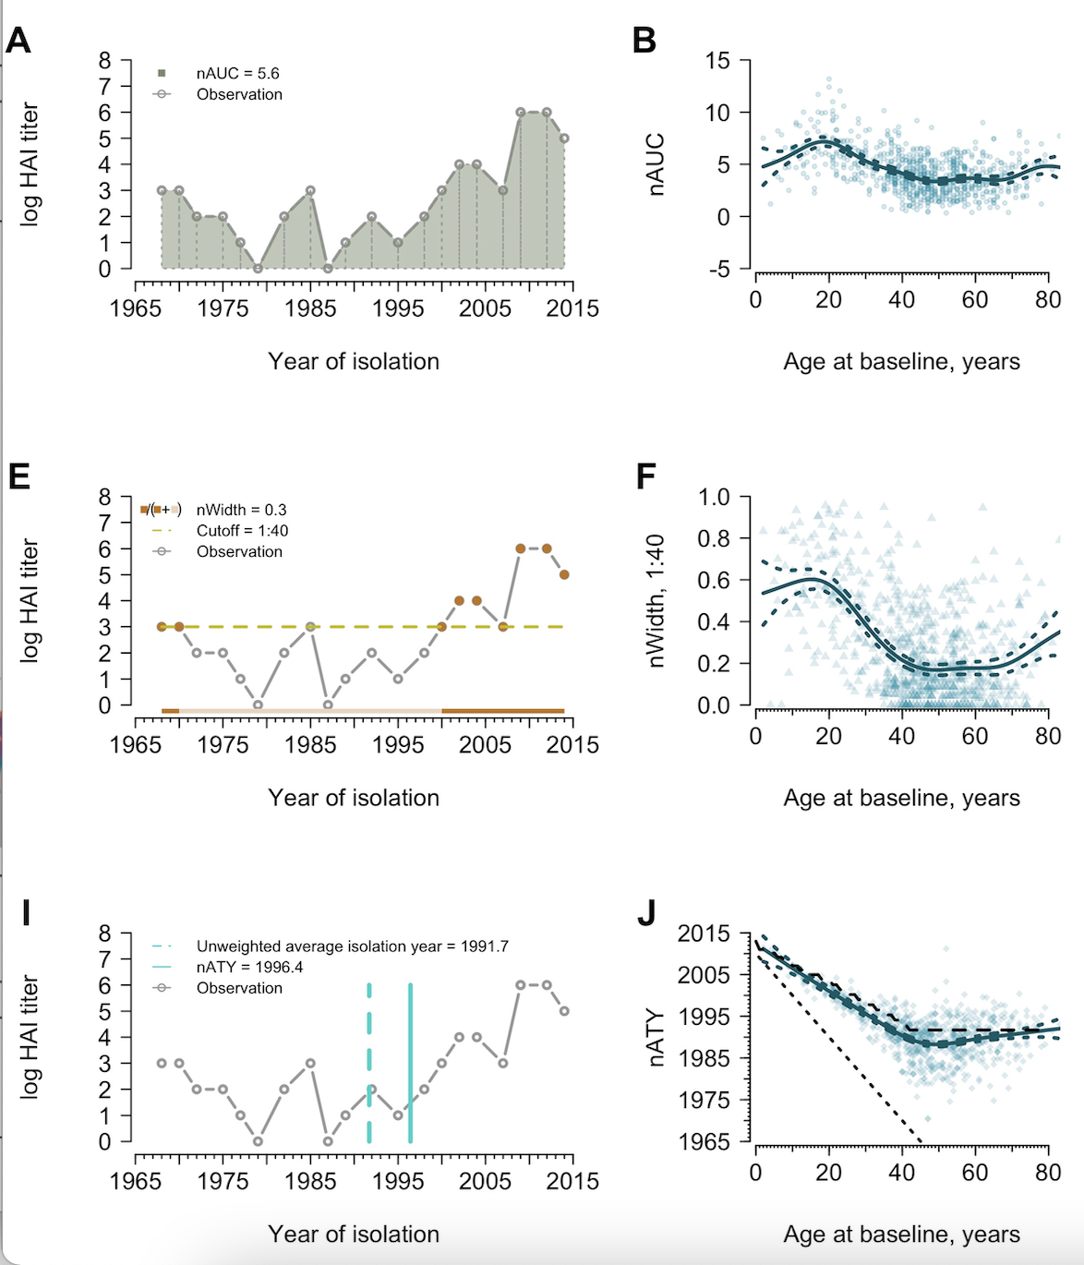
Metrics of Antibody Profiles
Area under the curve
Exclusion of pre-birth strains
Proportion of time above threshold
Proportion out of 1
Threshold decided by researcher
1:40 used for protection
1:10 used for detection
How immunity to strains circulating at different times contributes to the overall immune profile
Childhood biased: year is closer to birth year
Equally biased: year is half the age of the individual
Average Titer year
Yang B, Lessler J, Zhu H, Jiang CQ, Read JM, Hay JA, et al. (2020) Life course exposures continually shape antibody profiles and risk of seroconversion to influenza. PLoS Pathog 16(7): e1008635. https://doi.org/10.1371/journal.ppat.1008635

Slide 13
Main questions
Can we use use these measures to quantify the protective breadth of influenza vaccines?
Does the high dose influenza vaccine elicit a greater breadth of an antibody response?
Do the different antigenic distance measure effect the overall conclusions?

Slide 14
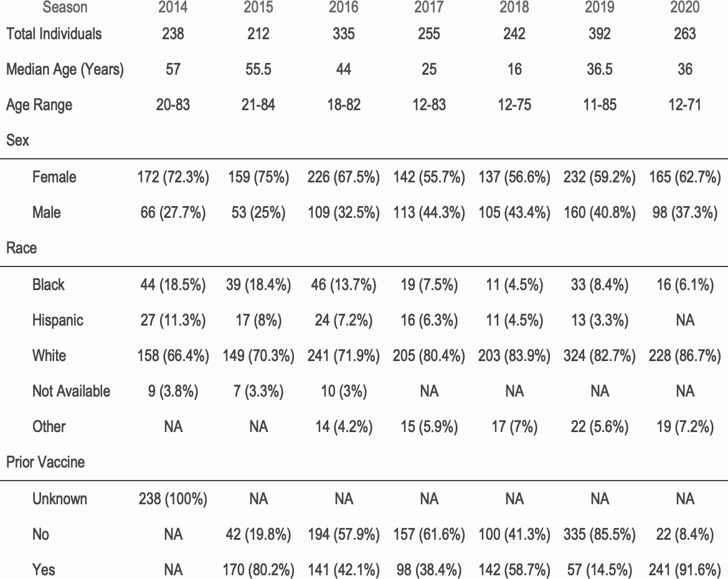
Flu Cohort
Table 2: Participants enrolled each influenza vaccine season.
Recruited cohort
Vaccinated with commercial influenza vaccine
High dose (45ug of protein)
Standard dose (15ug of protein)
HAI titers
Pre-vaccination
Post-vaccination

Slide 15
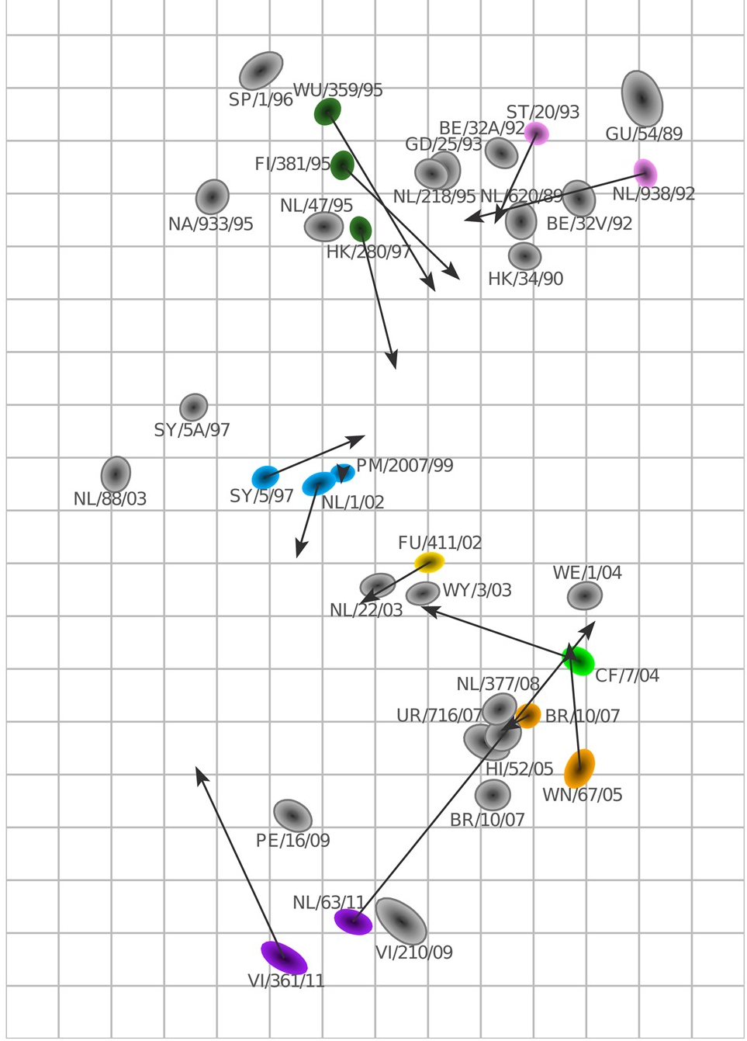
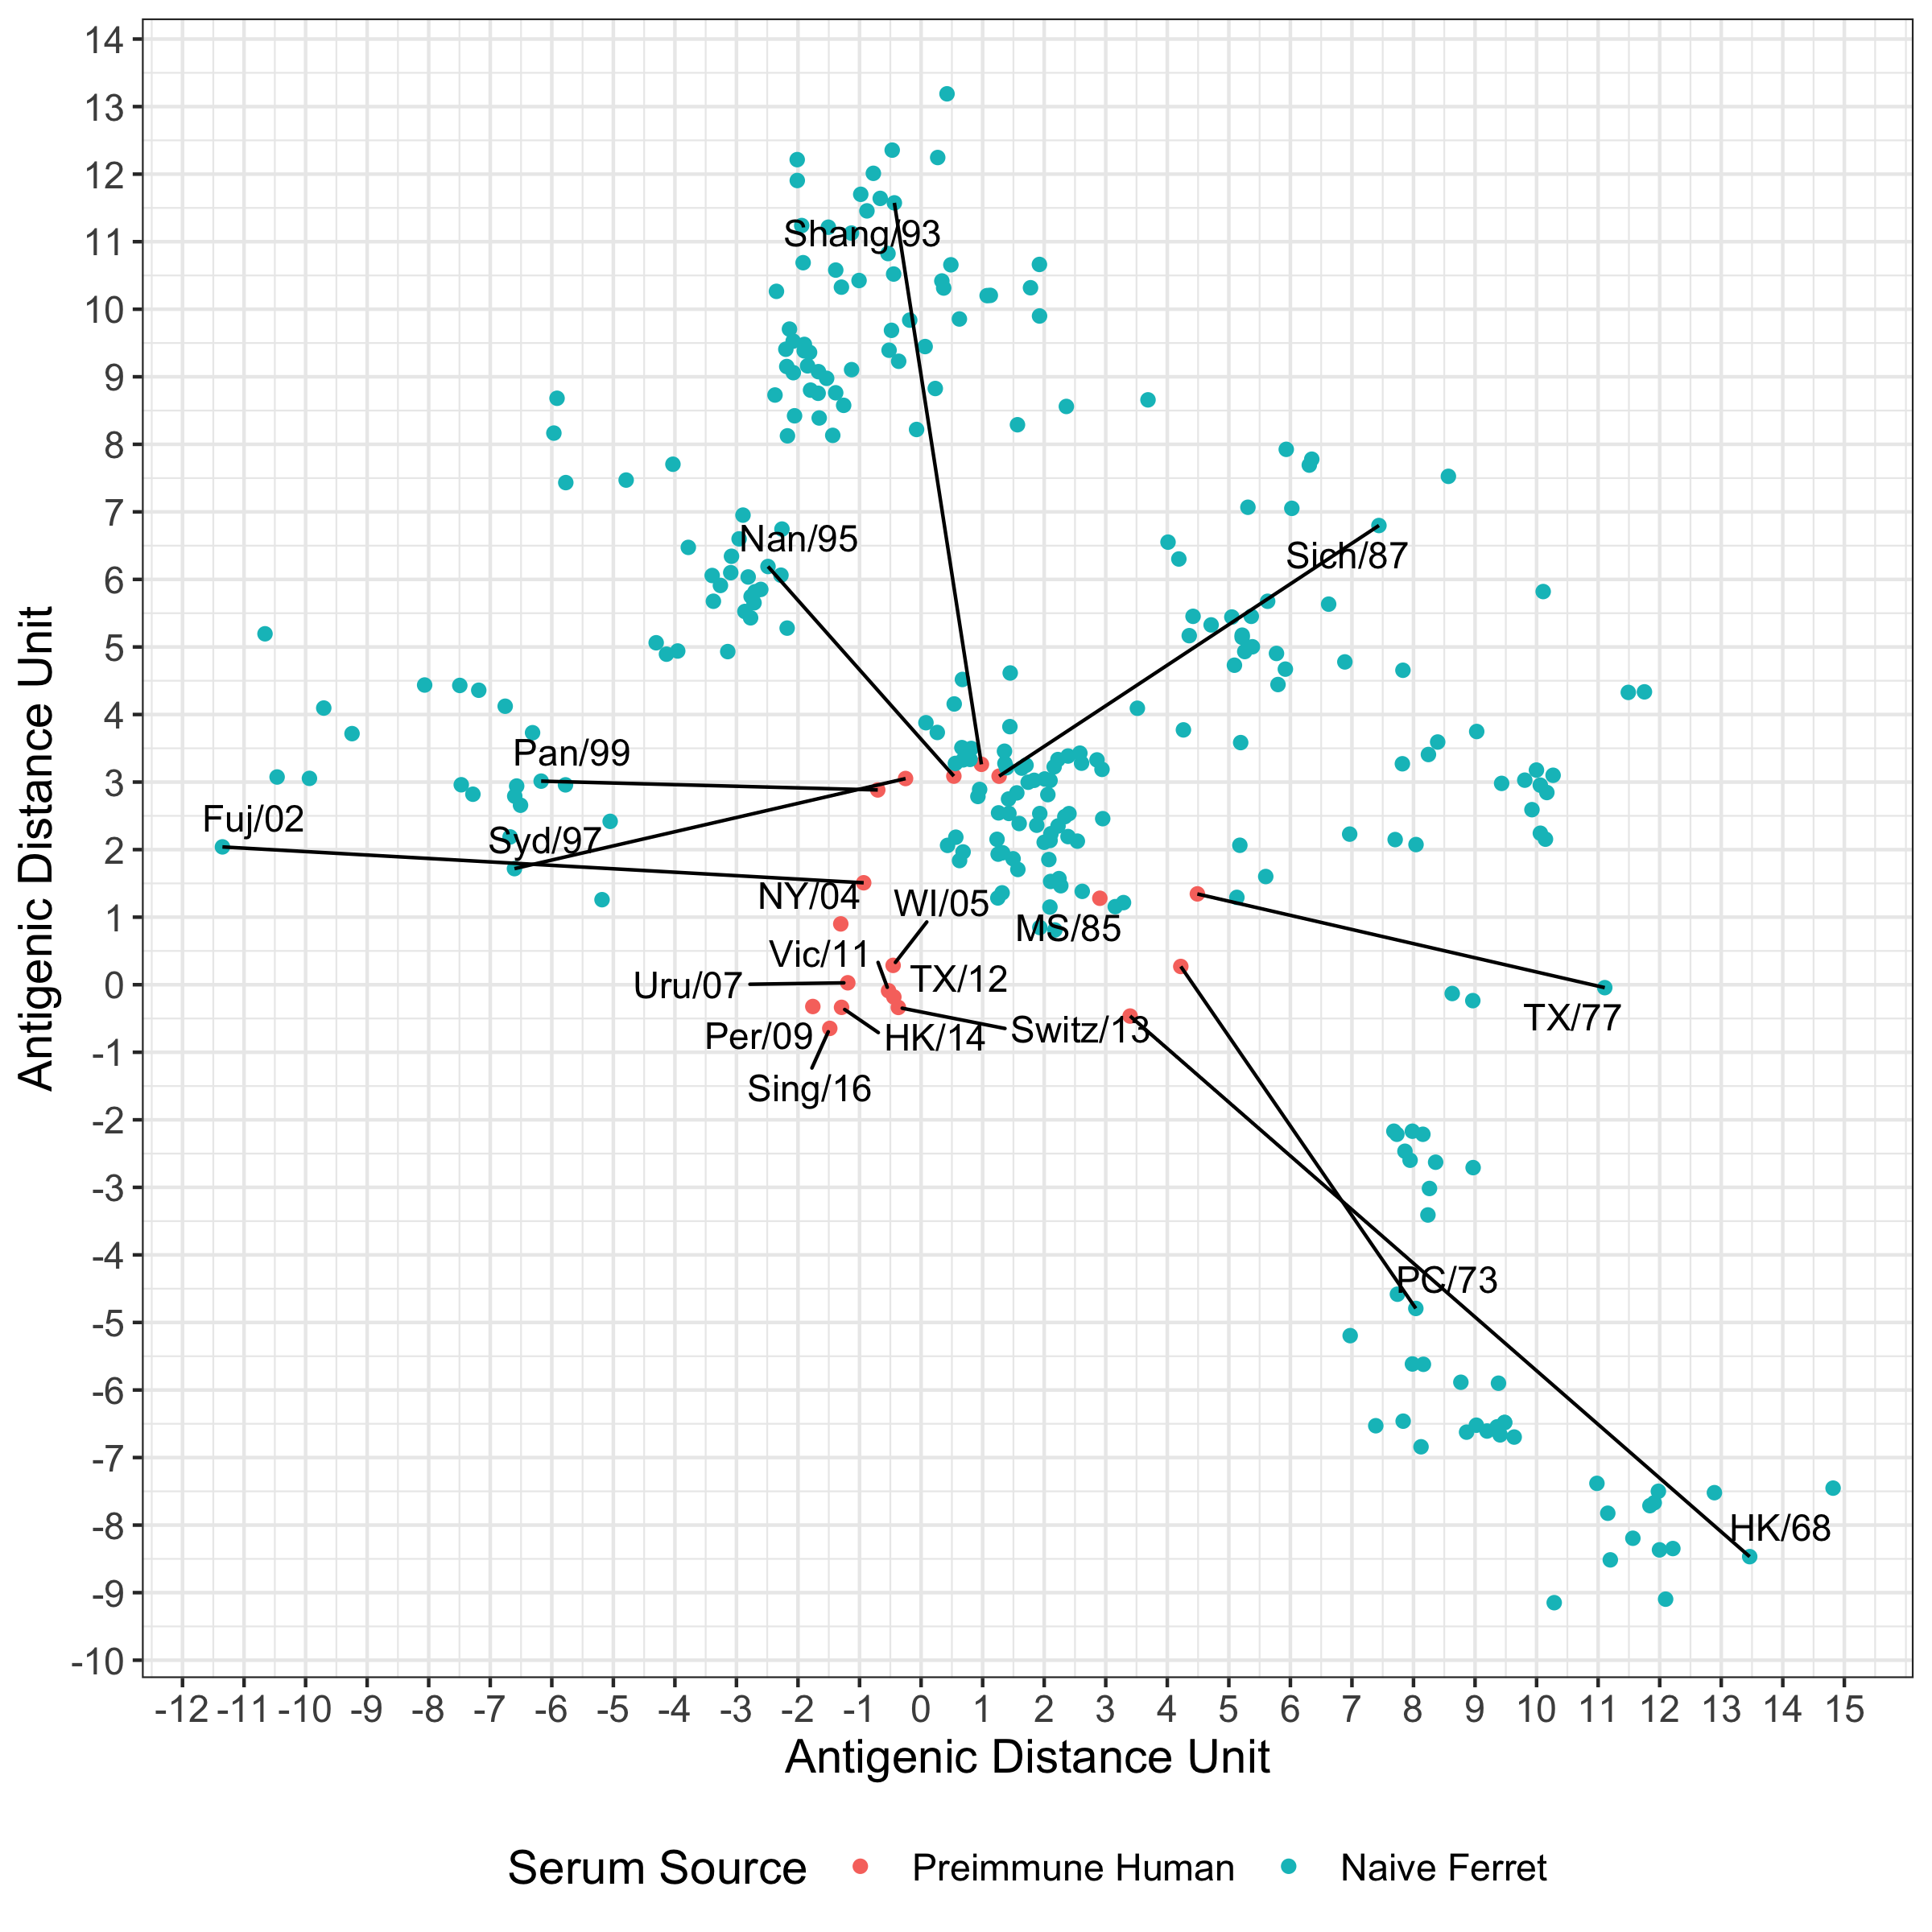
Sera for cartographic distances
Distances are shorter with human sera
Pre-existing cross-reactive antibodies in preimmune human sera makes distances smaller
Preimmune human distances use for analysis
Smith, 2004
Naïve Ferret
B. Fonville, 2016
Naïve Human
C. This Research
Preimmune Human

Slide 16
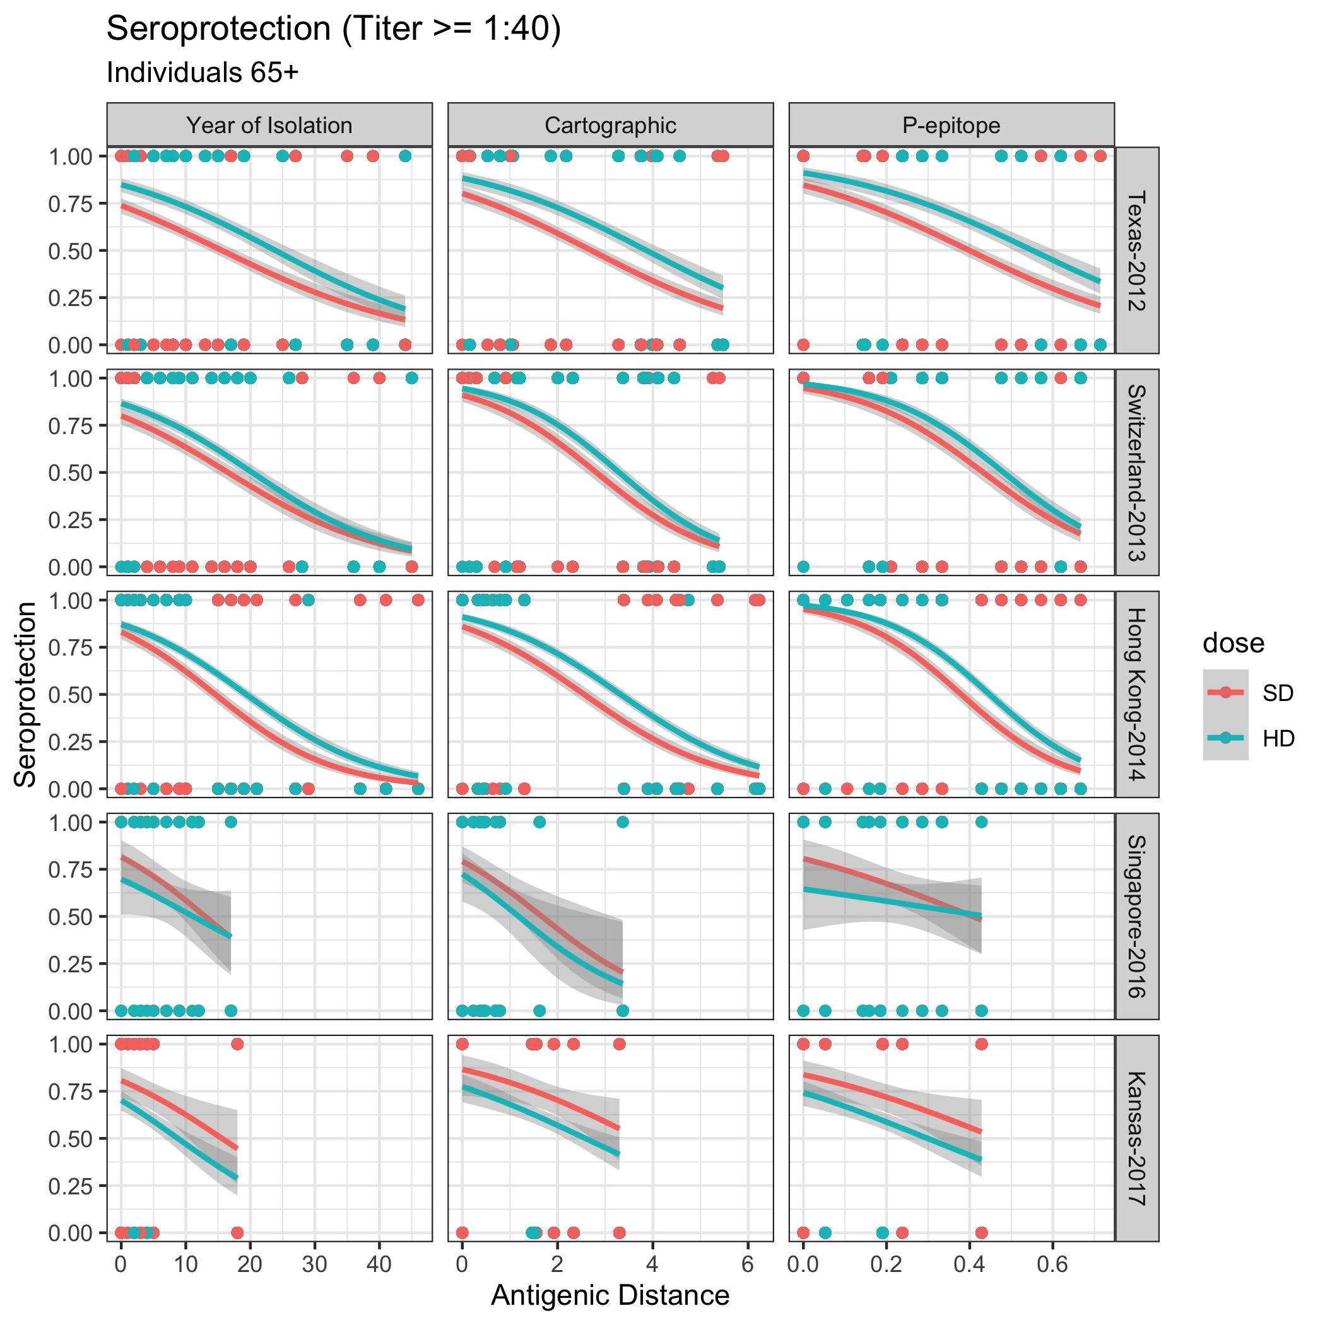
Protection of vaccines
Curves are similar between the different measures when stratified by vaccine strain
Standard dose for recent vaccine strains have greater seroprotection proportions than high dose.

Slide 17
Acknowledgements
All human samples and assays were conducted in accordance with UGA IRB guidelines. Diagrams created with BioRender.com. Data analysis and antigenic cartography were conducted in R using the Racmacs package (https://github.com/acorg/Racmacs) to generate the maps.
Georgia Research Alliance
NIH/NIAID - CIVIC – CIVR – HRP (Contract: 75N93019C00052)
UGA CIVIC Data Research Group:
Andreas Handel
Ye Shen
Yang Ge
Zane Billings
Michael Carlock
Conflict of Interest: None

